Slide 1
EXERGAMING
FOR MOTION DATA ACHIEVEMENT
Wearable Sensors Project by Nicolas Rossi
Academic Year 2022/2023

Slide 2
What is «Exergaming»?
Composed by the words “Exercise” + “Gaming”
Thought to make physical activity an exciting experience, encouraging its spread for people of all ages
First massive diffusion thanks to the Wii Fit Balance Board games in 2007, with a previous introduction in the gaming industries in the ‘80s with Konami’s Dance Dance Revolution arcade cabinet.
Market under great expansion, innovatively regarding VR Motion Tracking
Can this gaming activity be useful in a future perspective for Healthcare and Big Data Analysis?

Slide 3
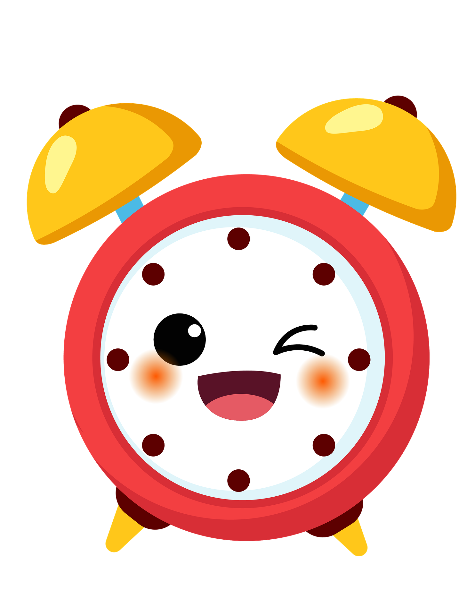
Main Scopes of Exergaming
Gamification of physical exercise to deal with the increasing sedentary lifestyle worldwide [1] as well as rehabilitation practices and physiotherapy
Effective way to obtain coherent motion data in a laboratory environment, for example by extending the attention span of kids and the naturalness of the requested movements
Possible Online data acquisition outside of the laboratory using smartphones or specific wearable sensors
Appliable to wide-spread achievement of anonymous training data for motion recognition AIs, and similar fields [2]
[1] https://www.who.int/news/item/19-10-2022-who-highlights-high-cost-of-physical-inactivity-in-first-ever-global-report
[2] https://doi.org/10.1145/2629465

Slide 4


Scope and functioning of the Game
Acquisition of data for three types of movements (run, jump and squat) while exer-playing with a demo game project created with GODOT Game Engine
Characters (cat or dog) and UI style (cartoonish) thought for kids in this specific case, but can be modified for an audience of teenagers or seniors
The focus in the game is to avoid obstacles that will appear along the way, executing the right movement for each type
Calibration is needed before starting the game
After the start, the whole session will be recorded using the accelerometer in the player’s Smartphone and an external application communicating via Wi-Fi with the game (Godot Remote)
The motion data will be saved locally for every run (completed or not) as a .txt file

Slide 5
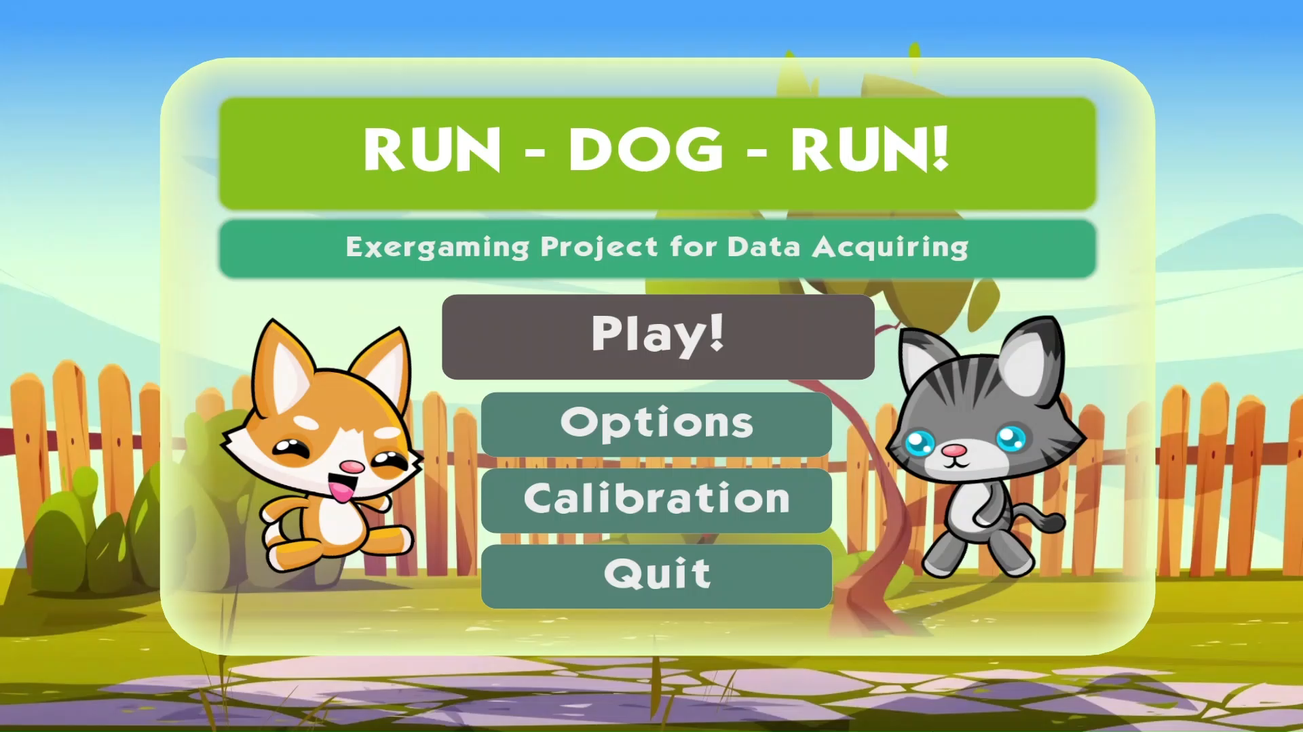
Calibration procedure

Slide 6
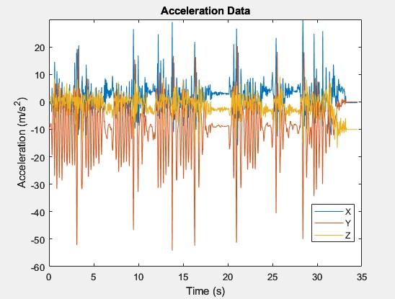
The obtained text file can then be analyzed by executing a MATLAB script that simply translates the string into acceleration data, applies a low pass filter and plots the data

Slide 7
The next slide is an example
of a complete run:

Slide 8
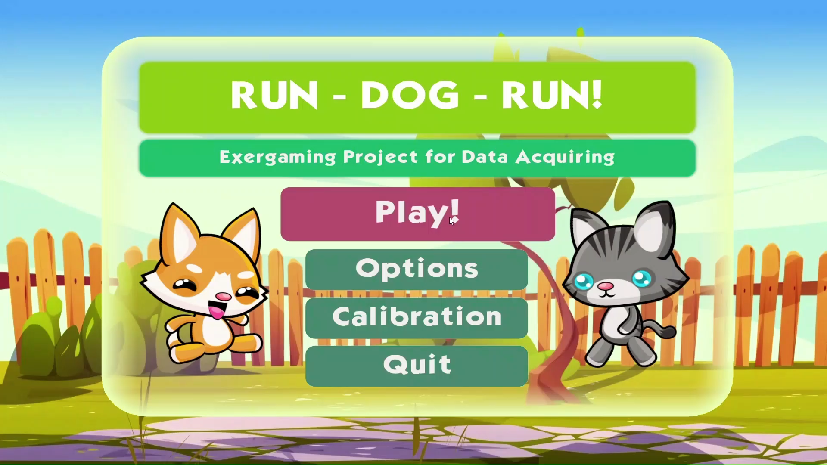

Slide 9
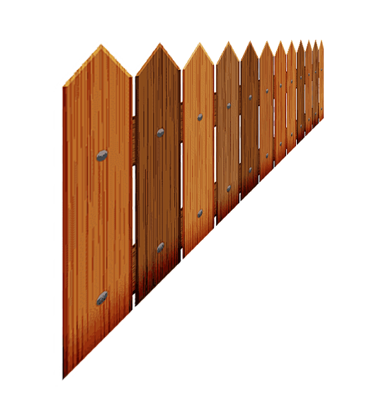

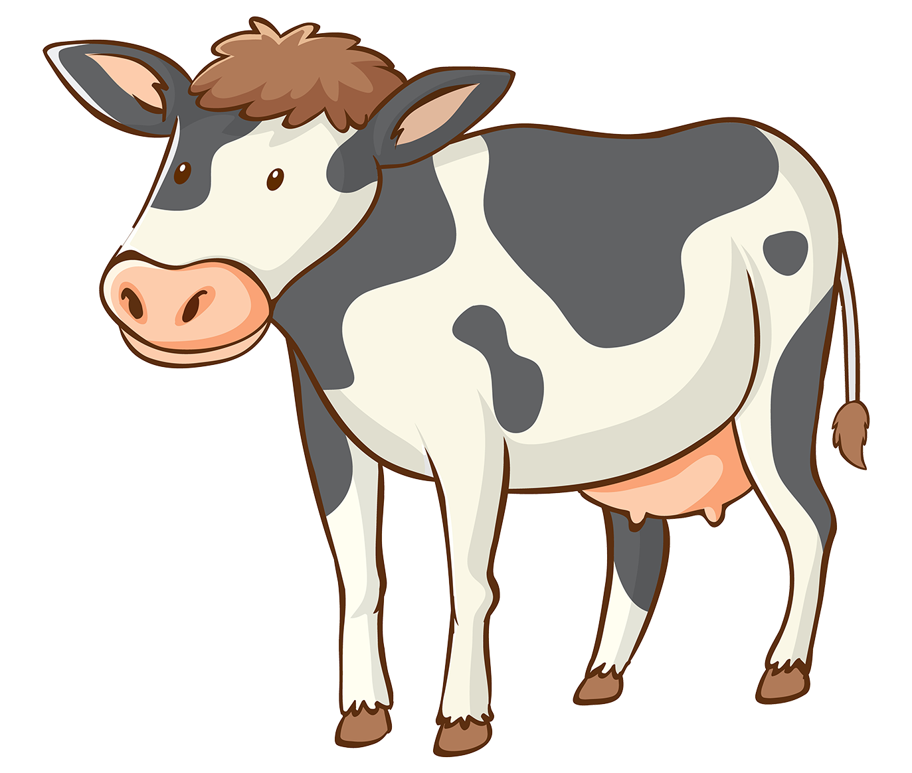
Possible Improvements to the Game
Add a tutorial and more levels or even characters to choose from
Enhance calibration for better movement recognition (especially squat)
Send the data directly online instead of saving locally (so that you will be able to access MATLAB on a unique PC while playing on other computers/consoles too)
Strengthen App to PC connection and reduce the data loss during the acquisition (possibly with Bluetooth)

Slide 10
CONCLUSIONS
Implementing Exergaming for data acquirement could be an interesting and natural way to obtain information about a specific movement or set of motions
It allows to transfer the acquisition from the laboratory right at home, in a familiar environment but with a reduced range of available sensors
Gaming also has an impact in the mental status of the player: based on the type of game, one can experience higher concentration, quicker reflexes and even acute emotional states such as joy, stress or fear (for example in horror games)
Implementations with Virtual Reality or the Metaverse may result in an almost infinite range of exergaming implementations, revealing its potential among an increasing population of players and gaining importance for possible future clinical applications

Slide 11
Thanks for your Attention!

